Slide 1
論文神器
+ ChatGPT
布丁布丁吃布丁
blog@pulipuli.info
20230601

Slide 2

論文神器
https://pulipulichen.github.io/HTML5-Wrapped-Text-Formatter/index.html
為了能夠活用論文的本身，加上了更容易介接到ChatGPT的功能

Slide 3
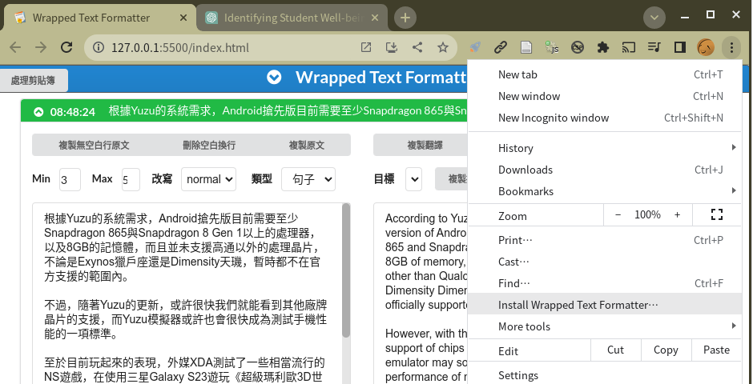
安裝
1
2

Slide 4
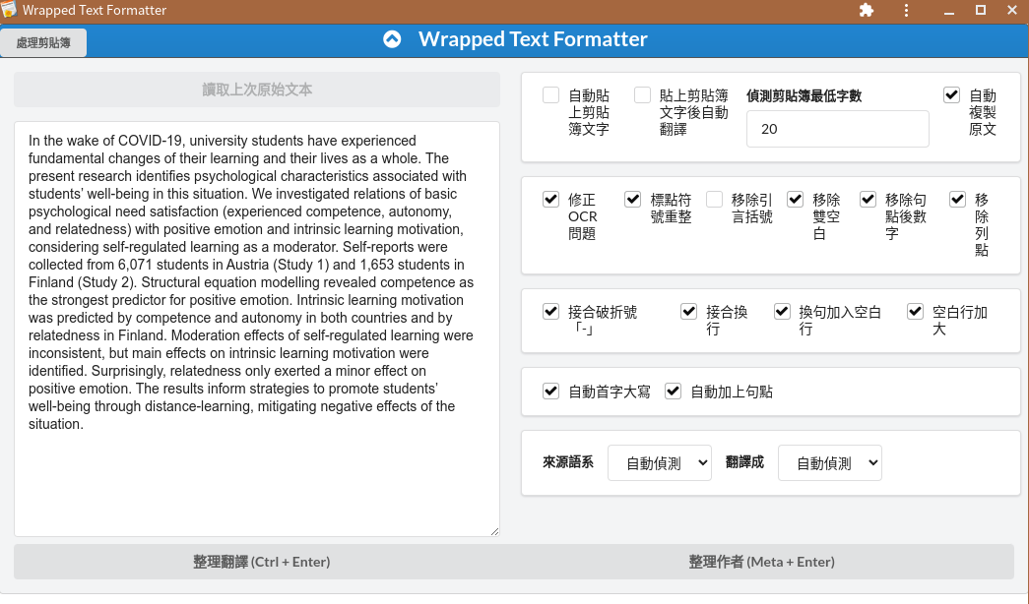
使用方法
1. 貼上
2. 整理翻譯

Slide 5
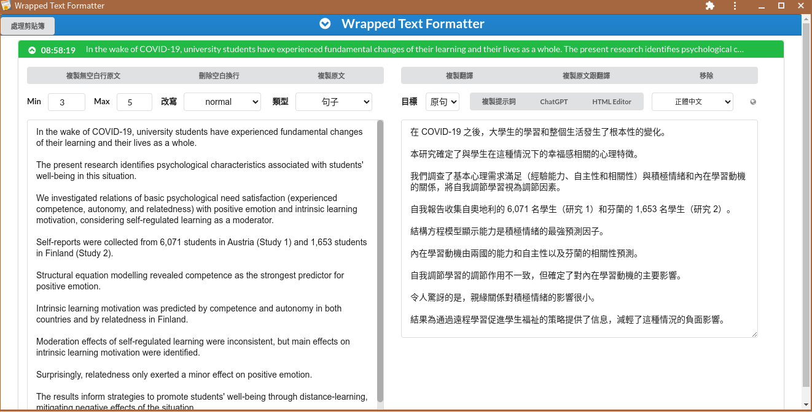
複製
1. 選項
2. 複製
3. ChatGPT

Slide 6
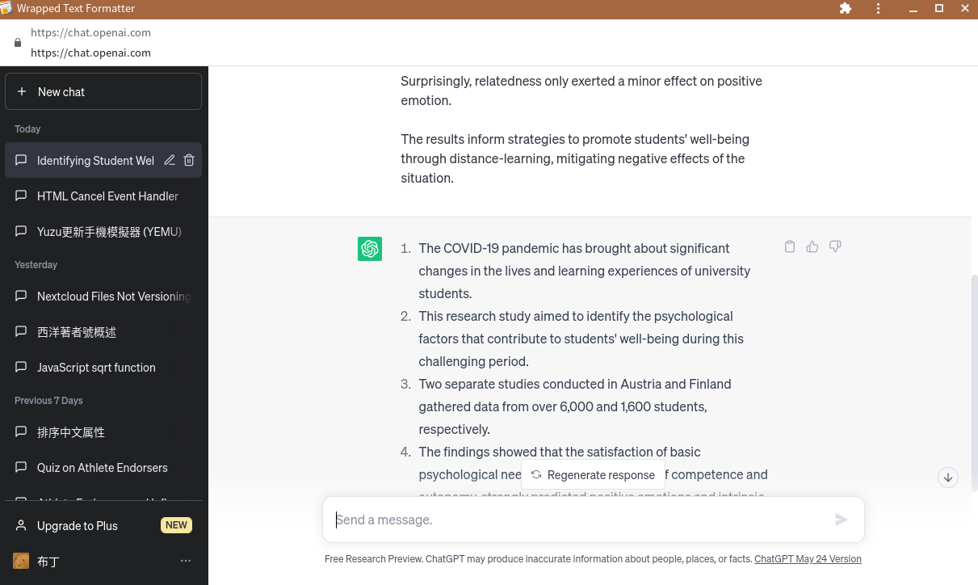
ChatGPT

Slide 7
選項
數量：Min、Max
改寫：普通、更短、更長
類型：
簡報使用：句子、關鍵字、心智圖
文章使用：段落
測驗使用：選擇題、申論題
目標：原句、翻譯

Slide 8
3 to 5 sentences in a list:
The COVID-19 pandemic has brought significant changes to university students' learning experiences and overall lives.
A research study examined how students' well-being during this period is influenced by their satisfaction of basic psychological needs, including competence, autonomy, and relatedness.
The study collected self-report data from over 6,000 students in Austria and over 1,600 students in Finland.
The findings revealed that competence was the strongest predictor of positive emotion, while both competence and autonomy were significant predictors of intrinsic learning motivation in both countries. Relatedness played a smaller role in positive emotion.
These results provide valuable insights for developing strategies to enhance students' well-being and minimize the negative impact of distance learning during challenging times such as the pandemic.

Slide 9
3 to 5 keywords:
COVID-19
University students
Psychological characteristics
Well-being
Distance learning

Slide 10
Please convert the following text into a mind map:
COVID-19 and its impact on university students
Fundamental changes in learning and lives
Research on psychological characteristics and well-being
Identifying psychological characteristics
Psychological need satisfaction (competence, autonomy, relatedness)
Relations with positive emotion
Relations with intrinsic learning motivation
Self-regulated learning as a moderator
Data collection…

Slide 11
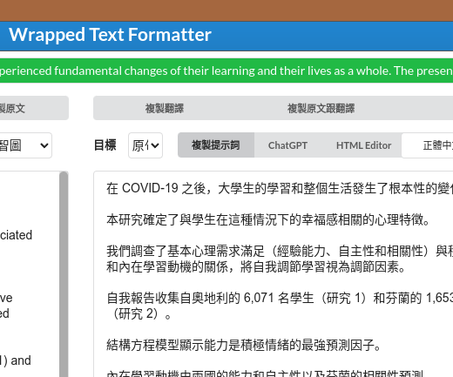
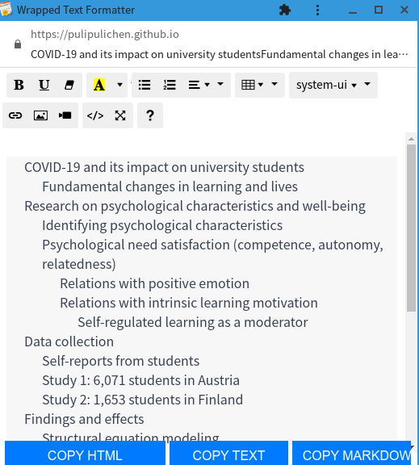
轉換給GitMind
1. 開啟
2. 貼上
3. 複製

Slide 12
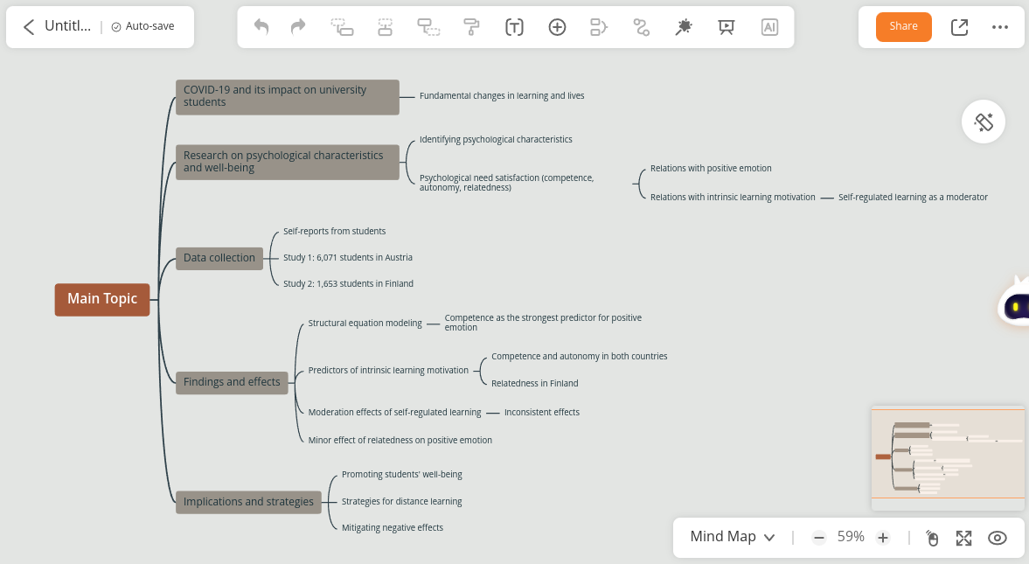
轉換給GitMind (cont.)
4. 貼上

Slide 13
Please format following text as 3 to 5 paragraphs:
In the wake of COVID-19, university students have undergone significant transformations in their learning experiences and overall lives. The present research focuses on identifying psychological characteristics associated with students' well-being during this challenging period. The study explored the relationships between basic psychological need satisfaction (competence, autonomy, and relatedness) and two key outcomes: positive emotion and intrinsic learning motivation. Additionally, the researchers considered self-regulated learning as a potential moderator in these relationships.
To gather data, self-reports were collected from a substantial number of students…

Slide 14
Please build a quiz with 3 options from the following text, and only one of the options is correct:
What psychological characteristics were investigated in the research study?
a) Autonomy, motivation, and discipline
b) Competence, autonomy, and relatedness
c) Resilience, perseverance, and self-esteem
Correct answer: b) Competence, autonomy, and relatedness

Slide 15
Please create an answer question from the following text, and give an answer between 200 to 300 words:
Question:
What were the key findings of the research study regarding the association between psychological characteristics and students' well-being during the COVID-19 pandemic, and how can these findings inform strategies to support students' well-being in distance-learning environments?

Slide 16
Please create an answer question from the following text, and give an answer between 200 to 300 words:
Answer:
The research study aimed to understand the psychological characteristics associated with the well-being of university students amidst the COVID-19 pandemic and how these characteristics relate to positive emotion and intrinsic learning motivation. The study collected self-report data from a large sample of 6,071 students in Austria (Study 1) and 1,653 students in Finland (Study 2). The findings revealed several key insights.
Firstly, …

Slide 17




如何使用？

Slide 18

報告完畢

